Slide 1
Exploring the Art of Intentional Camera Movement (ICM)
Transforming Photography into Abstract Art

Slide 2
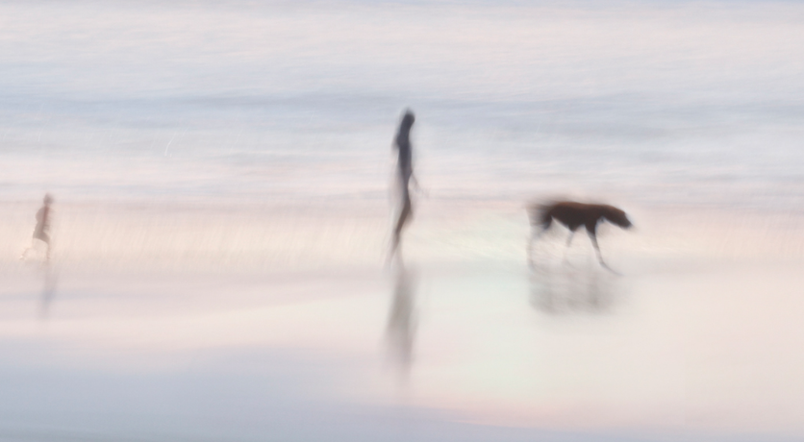
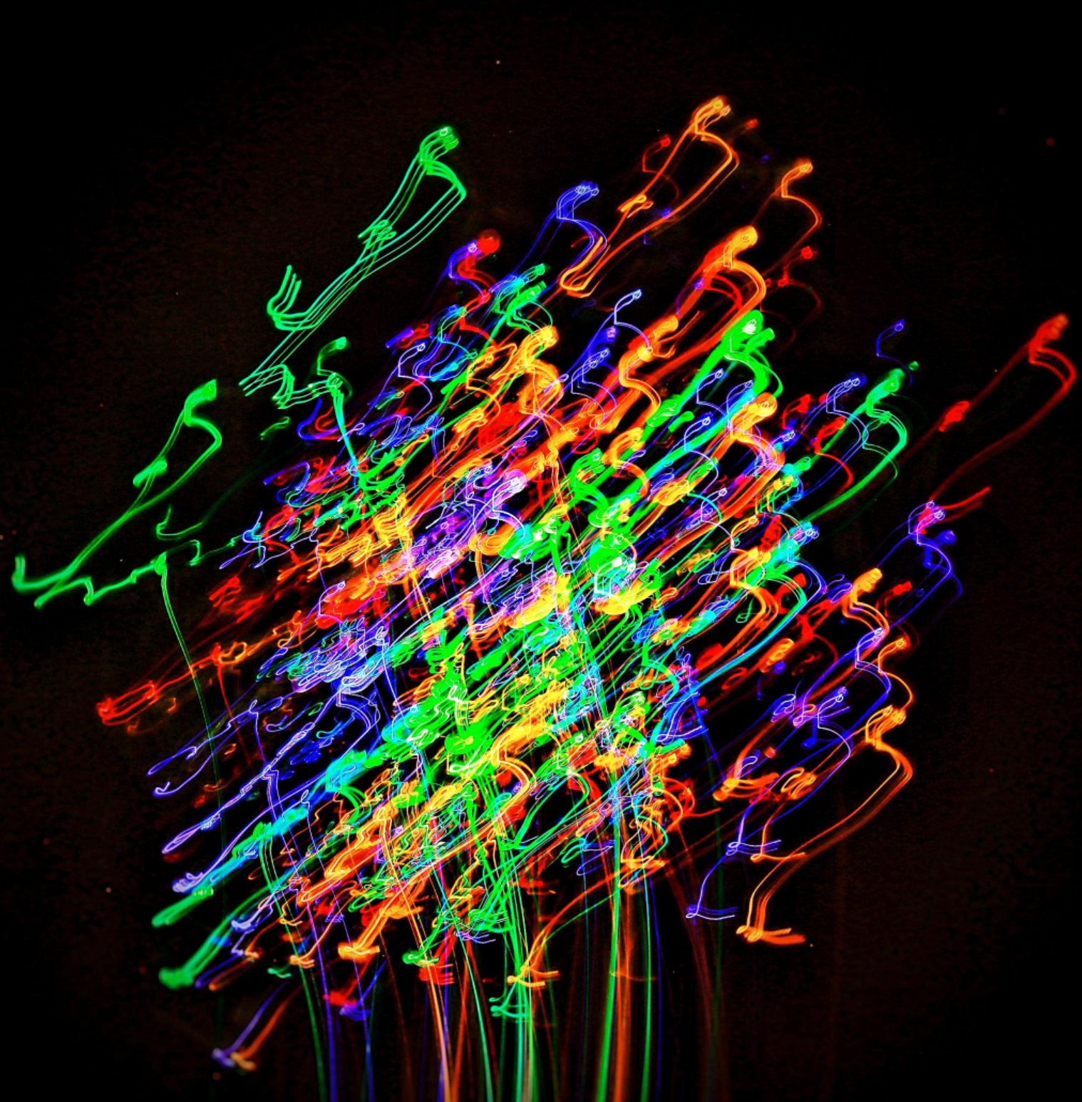
What is ICM
Definition: "Intentional Camera Movement is a photographic technique where the camera is deliberately moved during exposure to create artistic blur effects."
Mention its abstract and impressionistic qualities.
Trails of a static object
Use to enhance movement
Picture, Coen Camer
Picture, Judy Stokes

Slide 3
Why Use ICM
Adds creativity and uniqueness to photos.
Breaks traditional photography rules.
Creates dreamlike, painterly effects.
Enhances movement
Blending
Picture, Coen Camer

Slide 4
How ICM Photos Are Made
Use of slow shutter speeds (e.g., 1/15 to several seconds).
Movement techniques (e.g., panning, zooming, swaying).
Equipment: DSLR, tripod (optional), ND filters for daylight shots.
High F stop
Move….
Picture, Christian Hoiberg
Picture, Judy Stokes

Slide 5
Techniques for ICM
Panning: Moving the camera horizontally to follow a subject.
Zoom Burst: Adjusting the zoom during exposure.
Vertical Movement: Moving the camera up or down.
Horizontal movement:
Circular Motion: Rotating the camera for abstract patterns.
Shake it all about.
Long or short movements

Slide 6
Examples of ICM Photos
Picture by 2025 Masahiro Hiroike Photography

Slide 7
Examples of ICM Photos
Picture by James King

Slide 8
Examples of ICM Photos
By Cuttersnap

Slide 9
Tips for Successful ICM
Experiment with different shutter speeds and movements.
Use natural light creatively.
Practice to refine control over the camera.
Use of Licht points, torches or x-mas lights
Long exposure often asks for low ISO and High F-stop
1000”s shots

Slide 10
Using ICM as a Background Layer
Explanation: "ICM photos can be used as artistic backgrounds in composite images."
Example: A portrait with an ICM as background.
ar.inspiredpencil.com
42 west photography

Slide 11
Using ICM to freeze moments
Panning

Slide 12
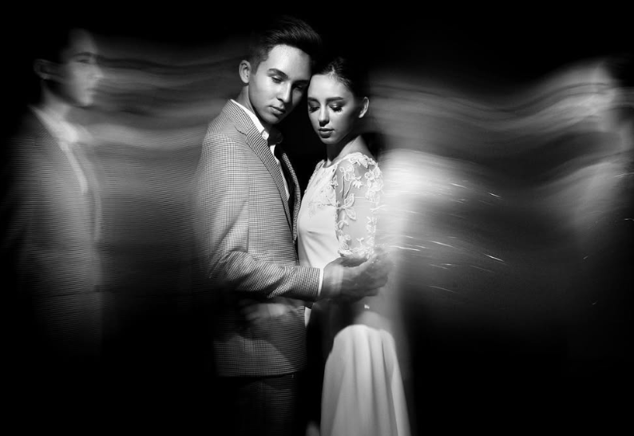
Try ICM
Well lit edge of a object (or two)
Manual,
High F stop (big number),
Low Iso
0.5 or 2 seconds… or Bulb
Hold, open, move, hold, close
Кемран Ширалиев

